Slide 1
Bio& 241 Unit 1 / Lecture 2

Slide 2
Development of the Cell Theory
Hooke (1665) named the cell
Schwann (1800’s) states: all animals are made of cells
Pasteur (1859) disproved idea of spontaneous generation
living things arise from nonliving matter
Modern cell theory emerged

Slide 3
Modern Cell Theory
All organisms composed of cells and cell products.
Cell is the simplest structural and functional unit of life.
Organism’s structure and functions are due to the activities of its cells.
Cells come only from preexisting cells.
Cells of all species have many fundamental similarities.

Slide 4
Cell Size
Human cell size
most from 10 - 15 µm in diameter
egg cells (very large)100 µm diameter
nerve cell (very long) at 1 meter long
Limitations on cell size
cell growth increases volume faster than surface area
nutrient absorption and waste removal utilize surface

Slide 5
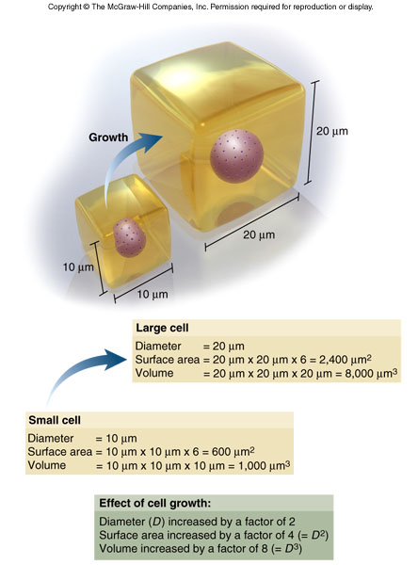
Cell Surface Area and Volume

Slide 6
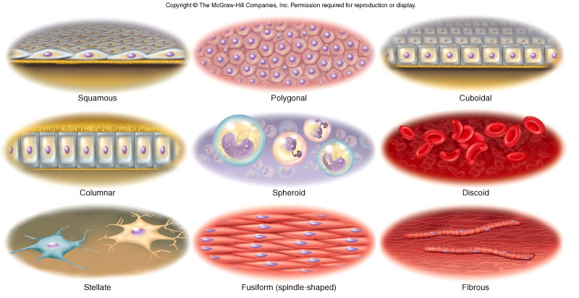
Cell Shape and Function

Slide 7
Cellular Organelles
See Pages 112 - 119

Slide 8
Fluid Mosaic Model for the Plasma Membrane

Slide 9
Functional Roles of Membrane Protein Molecules

Slide 10
Concentration Gradient of Ions across a Membrane and the Resulting Electrochemical Potential

Slide 11
Diffusion Rates
Factors affecting diffusion rate through a membrane
temperature - ↑ temp., ↑ motion of particles
molecular weight - larger molecules move slower
steepness of concentrated gradient - ↑difference, ↑ rate
membrane surface area - ↑ area, ↑ rate
membrane permeability - ↑ permeability, ↑ rate

Slide 12
Mechanisms of Membrane Transport of Materials into and outside of Cells

Slide 13
Primary Active Transport The Sodium/Potassium Pump
Found on many cell of the body including muscle
cells and nerve cells.

Slide 14
Tonicity
Tonicity - ability of a solution to affect fluid volume and pressure within a cell
depends on concentration and permeability of solute
Hypotonic solution
low concentration of nonpermeating solutes (high water concentration)
cells absorb water, swell and may burst (lyse)
Hypertonic solution
has high concentration of nonpermeating solutes (low water concentration)
cells lose water + shrivel (crenate)
Isotonic solution = normal saline

Slide 15
Movement of Water Across Plasma Membranes

Slide 16
Osmolarity
One osmole = 1 mole of dissolved particles
1M NaCl ( 1 mole Na⁺ ions + 1 mole Cl⁻ ions) thus 1M NaCl = 2 osm/L
Osmolarity = # osmoles/liter of solution
Physiological solutions are expressed in milliosmoles per liter (mOsm/L)
blood plasma = 300 mOsm/L
osmolality similar to osmolarity at concentration of body fluids

Slide 17
Components of the Cytoskeleton

Slide 18
Vesicular Transport
Endocytosis
1. Phagocytosis
2. Pinocytosis
Exocytosis

Slide 19
Stages of a Typical Cell Cycle
Interphase
1. G1: Cell duplicates organelle and cytosolic components
2. S: Replication of DNA
3. G2: Cell growth continues and synthesis of enzymes & proteins require for cell divisions

Slide 20
Clinical Terms Associated with Cells
Neoplasm: An abnormal formation of tissue; for example, a tumor.
Anaplasia: loss of differentiation of cells, an irreversible alteration in adult cells toward more primitive (embryonic) cell types
Dysplasia: Cells that look abnormal under a microscope but are not cancer
Hyperplasia: An abnormal increase in cells in a tissue or organ, excluding tumor formation, whereby the bulk of the tissue or organ is increased.
Metaplasia: Transformation of cells or tissues from a normal to abnormal states.
Apoptosis: Cell death in which a programmed sequence of events leads to the elimination of cells

